Slide 1
Continuing with Chapter 2.3
Intro to RStudio

Slide 2
What we have learned so far
What we need to learn today
Learned how to use R as a calculator
Learned how to write vectors
Learned how to manipulate and index vectors
Learned about strings and comments in R
Learned about variables, how to write and use them.
Learned basic functions
Learned about ls() and rm and rm(list=ls())
Learned the rnorm() function and its usefulness
How to record current Time
Learn about byrow in Matrices
Learn about lists and data frames
Learn how to use, evaluate, and load data from a package
Learn how to read data from a .data file, a .csv, Excel, and from a website.
Evaluate data with functions like summary, str, fix, head

Slide 3
Matrix
Matrix is another type of object like a vector or a list
x<-1:9 #Creating a Variable X that has 9 Values.
matrix(x, nrow=3, ncol=3) #Using matrix() function to create a matrix with 3 rows and 3 columns.
## [,1] [,2] [,3] ## [1,] 1 4 7 ## [2,] 2 5 8 ## [3,] 3 6 9
matrix(1:9,3,3) ##Take note how the matrix fills in the new data.
## [,1] [,2] [,3] ## [1,] 1 4 7 ## [2,] 2 5 8 ## [3,] 3 6 9
Note – we do not need to name the arguments because we go in the correct order.

Slide 4
Setting byrow Argument in a Matrix
m<-matrix(1:9,3,3,byrow=TRUE) m
## [,1] [,2] [,3] ## [1,] 1 2 3 ## [2,] 4 5 6 ## [3,] 7 8 9
##Fills the Matrix Across the Row and assigns it to variable m

Slide 5
Indexing a Matrix
m<-matrix(1:9,3,3,byrow=TRUE) m
## [,1] [,2] [,3] ## [1,] 1 2 3 ## [2,] 4 5 6 ## [3,] 7 8 9
m[1,] #select the first row
## [1] 1 2 3
m[,1] #select the first column
## [1] 1 4 7
m[1,2] #select an element in the first row and second column
## [1] 2
#Use the negative sign to tell R to keep all rows or columns except those indicated m[-1,]
## [,1] [,2] [,3] ## [1,] 4 5 6 ## [2,] 7 8 9
m[-c(1,3),]##if it is not an array, you need the c() function to combine values.
## [1] 4 5 6
m[-(1:2),]##Note the parentheses
## [1] 7 8 9

Slide 6
Data Frame
A data frame is a table or a two-dimensional array-like structure in which each column contains values of one variable and each row contains one set of values from each column.
Similarly, in R – they are generic data objects to store tabular data.
The column names should be non-empty.
The row names should be unique.
The data stored in a data frame can be of numeric, factor or character type.
Each column should contain same number of data items.
library(MASS) data("Insurance") head(Insurance)
## District Group Age Holders Claims ## 1 1 <1l <25 197 38 ## 2 1 <1l 25-29 264 35 ## 3 1 <1l 30-35 246 20 ## 4 1 <1l >35 1680 156 ## 5 1 1-1.5l <25 284 63 ## 6 1 1-1.5l 25-29 536 84
In a data frame the columns contain different types of data, but in a matrix all the elements are the same type of data. A matrix is usually numbers.
The matrix can be looked at as a vector with additional methods or dimensions, while a data frame is a list.

Slide 7
Indexing a Data Frame
## District Group Age Holders Claims ## 1 1 <1l <25 197 38 ## 2 1 <1l 25-29 264 35 ## 3 1 <1l 30-35 246 20 We index Data Frames the same way as a Matrix
first5rows <- Insurance[1:5,] ##Pull the first 5 rows first2cols <- Insurance[,1:2] ##pull the first 2 columns AllButRow7 <- Insurance[-7,] ##All but row 7 AllButCol1_2 <- Insurance[,-(1:2)] ##All but columns 1 and 2

Slide 8
Lists in R
A list is a collection of elements which can have different data types.
These elements do not have any restriction on the class, length or structure of each element
Data frames are lists, but they have a few restrictions mentioned above:
you can't use the same name for two different variables
all elements of a data frame are vectors
all elements of a data frame have an equal length.
A data frame fits a dataset that is a 2 dimensional structure.
l<- list(1234,'Machine Learning’,’BUAD5072') l[1] ##The value in the first position of the list
## [[1]] ## [1] 1234
Indexing is also the same as Matrices and Data Frames
l[2] ##The value in the second position of the list
## [[1]] ## [1] "Machine Learning"
l2<-list(Employee=c("Sally“),Salary=c(40000)) l2$Employee ##List values can be accessed by name using the $
## [1] "Sally“

Slide 9
Inspecting Data Structures: All incredibly useful functions for Analytics
The str() function helps you look at data structures and compactly displays the internal structure of an R object.
l2<-list(Employee="Sally",Salary=40000)
str(l2)
## List of 2 ## $ Employee: chr "Sally" ## $ Salary : num 40000
library(MASS); data("Insurance")
str(Insurance)
## 'data.frame': 64 obs. of 5 variables: ## $ District: Factor w/ 4 levels "1","2","3","4": 1 1 1 1 1 1 1 1 1 1 ... ## $ Group : Ord.factor w/ 4 levels "<1l"<"1-1.5l"<..: 1 1 1 1 2 2 2 2 3 3 ... ## $ Age : Ord.factor w/ 4 levels "<25"<"25-29"<..: 1 2 3 4 1 2 3 4 1 2 ... ## $ Holders : int 197 264 246 1680 284 536 696 3582 133 286 ... ## $ Claims : int 38 35 20 156 63 84 89 400 19 52 ...
The class() function finds the class the object belongs to.
class(l2)
## [1] "list"
class(Insurance)
## [1] "data.frame"
The summary() function gives you more detailed information on a data structure.
summary(l2)
## Length Class Mode ## Employee 1 -none- character ## Salary 1 -none- numeric
summary(Insurance)
## District Group Age Holders Claims ## 1:16 <1l :16 <25 :16 Min. : 3.00 Min. : 0.00 ## 2:16 1-1.5l:16 25-29:16 1st Qu.: 46.75 1st Qu.: 9.50 ## 3:16 1.5-2l:16 30-35:16 Median : 136.00 Median : 22.00 ## 4:16 >2l :16 >35 :16 Mean : 364.98 Mean : 49.23 ## 3rd Qu.: 327.50 3rd Qu.: 55.50 ## Max. :3582.00 Max. :400.00

Slide 10
Read from .data file
Auto<-read.table("Auto.data",header=TRUE, stringsAsFactors=TRUE) fix(Auto) str(Auto)
## 'data.frame': 397 obs. of 9 variables: ## $ mpg : num 18 15 18 16 17 15 14 14 14 15 ... ## $ cylinders : num 8 8 8 8 8 8 8 8 8 8 ... ## $ displacement: num 307 350 318 304 302 429 454 440 455 390 ... ## $ horsepower : Factor w/ 94 levels "?","100.0","102.0",..: 17 35 29 29 24 42 47 46 48 40 ... ## $ weight : num 3504 3693 3436 3433 3449 ... ## $ acceleration: num 12 11.5 11 12 10.5 10 9 8.5 10 8.5 ... ## $ year : num 70 70 70 70 70 70 70 70 70 70 ... ## $ origin : num 1 1 1 1 1 1 1 1 1 1 ... ## $ name : Factor w/ 304 levels "amc ambassador brougham",..: 49 36 231 14 161 141 54 223 241 2 ...

Slide 11
Read from .csv file
Auto2<- read.csv("Auto.csv",stringsAsFactors = TRUE) head(Auto2)
## mpg cylinders displacement horsepower weight acceleration year origin ## 1 18 8 307 130 3504 12.0 70 1 ## 2 15 8 350 165 3693 11.5 70 1 ## 3 18 8 318 150 3436 11.0 70 1 ## 4 16 8 304 150 3433 12.0 70 1 ## 5 17 8 302 140 3449 10.5 70 1 ## 6 15 8 429 198 4341 10.0 70 1 ## name ## 1 chevrolet chevelle malibu ## 2 buick skylark 320 ## 3 plymouth satellite ## 4 amc rebel sst ## 5 ford torino ## 6 ford galaxie 500
str(Auto2)
## 'data.frame': 397 obs. of 9 variables: ## $ mpg : num 18 15 18 16 17 15 14 14 14 15 ... ## $ cylinders : int 8 8 8 8 8 8 8 8 8 8 ... ## $ displacement: num 307 350 318 304 302 429 454 440 455 390 ... ## $ horsepower : Factor w/ 94 levels "?","100","102",..: 17 35 29 29 24 42 47 46 48 40 ... ## $ weight : int 3504 3693 3436 3433 3449 4341 4354 4312 4425 3850 ... ## $ acceleration: num 12 11.5 11 12 10.5 10 9 8.5 10 8.5 ... ## $ year : int 70 70 70 70 70 70 70 70 70 70 ... ## $ origin : int 1 1 1 1 1 1 1 1 1 1 ... ## $ name : Factor w/ 304 levels "amc ambassador brougham",..: 49 36 231 14 161 141 54 223 241 2 ...
fix(Auto2)

Slide 12
Read from Excel file
There are many ways to read in an Excel file into R.
I used the readxl package.
library(readxl) Auto3<- read_excel("Auto.xlsx") Auto3 <- na.omit(Auto3) fix(Auto3) head(Auto3)
str(Auto3)

Slide 13
Reading Data from the Web
fileURL <- "https://www.statlearning.com/s/Auto.csv " download.file(fileURL,destfile="./Auto.csv") list.files("./")
## [1] "Auto.csv"
Auto4<- read.csv("./Auto.csv") head(Auto4)
## mpg cylinders displacement horsepower weight acceleration year origin ## 1 18 8 307 130 3504 12.0 70 1 ## 2 15 8 350 165 3693 11.5 70 1 ## 3 18 8 318 150 3436 11.0 70 1 ## 4 16 8 304 150 3433 12.0 70 1 ## 5 17 8 302 140 3449 10.5 70 1 ## 6 15 8 429 198 4341 10.0 70 1 ## name ## 1 chevrolet chevelle malibu ## 2 buick skylark 320 ## 3 plymouth satellite ## 4 amc rebel sst ## 5 ford torino ## 6 ford galaxie 500
fix(Auto4)

Slide 14
Coercion
When you call a function with an argument of the wrong type, R will try to coerce values to a different type so that the function will work.
Fixing the name variable
class(Auto$name)
## [1] "factor"
Auto[,9]<-as.character(Auto[,9]) Auto[, 'name'] <- as.character(Auto[, 'name']) ##Same as above
str(Auto)

Slide 15
dplyr library
library(dplyr)
dplyr is a data manipulation package, providing a consistent set of verbs that help you solve the most common data manipulation challenges:
mutate() adds new variables that are functions of existing variables.
select() picks variables based on their names.
filter() picks cases based on their values.

Slide 16
Comparing summarize from dplyr with summary
summary(Auto)
## mpg cylinders displacement horsepower weight ## Min. : 9.00 Min. :3.000 Min. : 68.0 Min. : 46.0 Min. :1613 ## 1st Qu.:17.50 1st Qu.:4.000 1st Qu.:104.0 1st Qu.: 75.0 1st Qu.:2223 ## Median :23.00 Median :4.000 Median :146.0 Median : 93.5 Median :2800 ## Mean :23.52 Mean :5.458 Mean :193.5 Mean :104.5 Mean :2970 ## 3rd Qu.:29.00 3rd Qu.:8.000 3rd Qu.:262.0 3rd Qu.:126.0 3rd Qu.:3609 ## Max. :46.60 Max. :8.000 Max. :455.0 Max. :230.0 Max. :5140 ## NA's :5 ## acceleration year origin name ## Min. : 8.00 Min. :70.00 Min. :1.000 Length:397 ## 1st Qu.:13.80 1st Qu.:73.00 1st Qu.:1.000 Class :character ## Median :15.50 Median :76.00 Median :1.000 Mode :character ## Mean :15.56 Mean :75.99 Mean :1.574 ## 3rd Qu.:17.10 3rd Qu.:79.00 3rd Qu.:2.000 ## Max. :24.80 Max. :82.00 Max. :3.000 ##
summarize(Auto,avg=mean(mpg))
## avg ## 1 23.51587

Slide 17
Editing The horsepower Variable
We can use the filter command to filter out the ? Question mark values.
class(Auto$horsepower)
## [1] "numeric"
Questions<-filter(Auto,horsepower=="?")
Auto[,4]<-as.numeric(unlist(Auto[,4]))
summary(Auto $horsepower)
## Min. 1st Qu. Median Mean 3rd Qu. Max. NA's ## 46.0 75.0 93.5 104.5 126.0 230.0 5
Why you might need unlist:
Given a list structure x, the unlist() function simplifies it to produce a vector which contains all the atomic components which occur in x

Slide 18
Separating Columns in R
Separate first three columns
firstgroup<-select(Auto,mpg,cylinders,displacement) head(newData)
## mpg cylinders displacement ## 1 18 8 307 ## 2 15 8 350 ## 3 18 8 318 ## 4 16 8 304 ## 5 17 8 302 ## 6 15 8 429
Separate last three columns
secondgroup<-select(Auto,horsepower,weight,acceleration) #part of dplyr package head(secondhalf)
## horsepower weight acceleration ## 1 130 3504 12.0 ## 2 165 3693 11.5 ## 3 150 3436 11.0 ## 4 150 3433 12.0 ## 5 140 3449 10.5 ## 6 198 4341 10.0
Bind Columns Back Together
mergedata<-cbind(firstgroup,secondgroup) head(mergedata)
## mpg cylinders displacement horsepower weight acceleration ## 1 18 8 307 130 3504 12.0 ## 2 15 8 350 165 3693 11.5 ## 3 18 8 318 150 3436 11.0 ## 4 16 8 304 150 3433 12.0 ## 5 17 8 302 140 3449 10.5 ## 6 15 8 429 198 4341 10.0

Slide 19
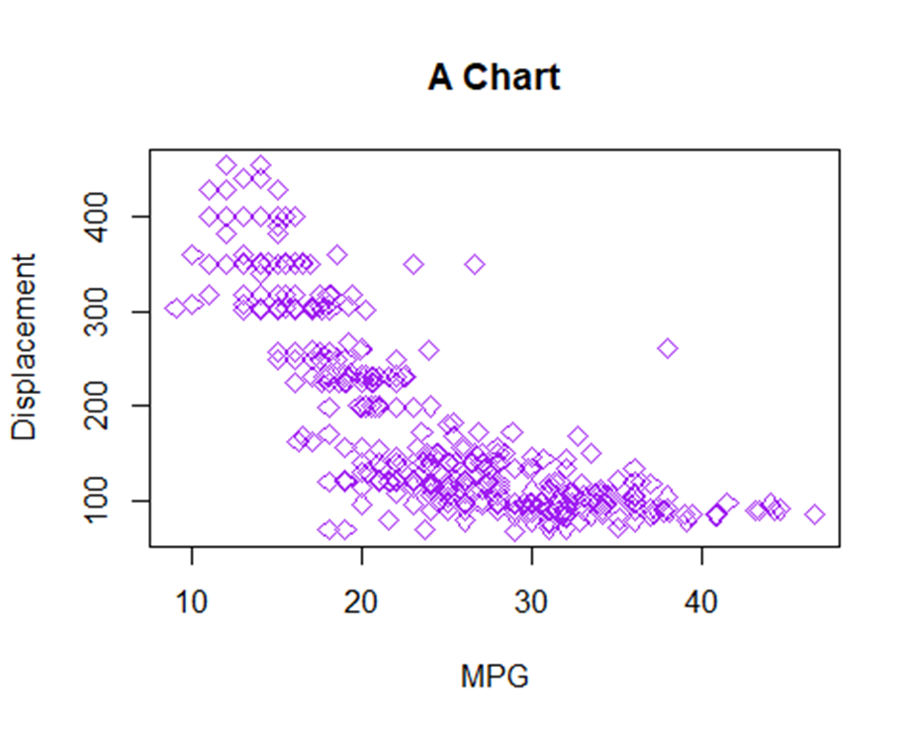
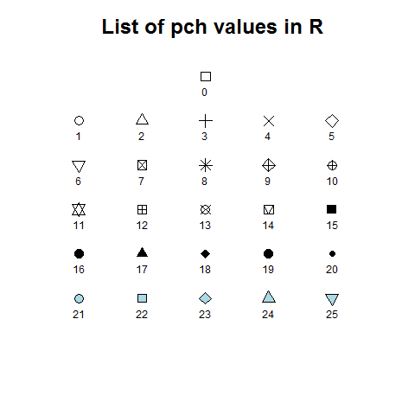
One Note from Base Graphics Swirl: Adding Color and Style to the Plot
Auto2<- read.csv("Auto.csv",stringsAsFactors = TRUE) plot(x=Auto2$mpg,y=Auto2$displacement,pch=5,col="purple",xlab="MPG", ylab="Displacement",main="A Chart")
You can add Hexadecimal Color with “#123456”
You can change pch values to a number between 1-25
Notes:
http://www.statisticstoproveanything.com/2010/09/charts-of-different-pch-values-in-r.html

Slide 20
For Next Time
Case Study Due This Friday!
Investigate the dplyr package on your own to see its full capabilities.
Work through Loading_Data Swirl lesson to get a sense of what you can do.
Note that this swirl is a little limited in just focusing on datasets in R and that you need to review what we did in class today as well.

